Slide 1
Chapter 6 Transport Layer
Prepared By:
Prof. Vishal A. Polara
Assistant Professor
Information Technology Department
Birla Vishvakarma Mahavidyalaya Engineering College

Slide 2
Outline
The transport service: Services provided to the upper layers, Transport service primitives, Socket
Elements of transport protocols: Addressing, Connection establishment, Connection release, Flow control, Multiplexing, Crash recovery.
The transport protocol: UDP, TCP

Slide 3
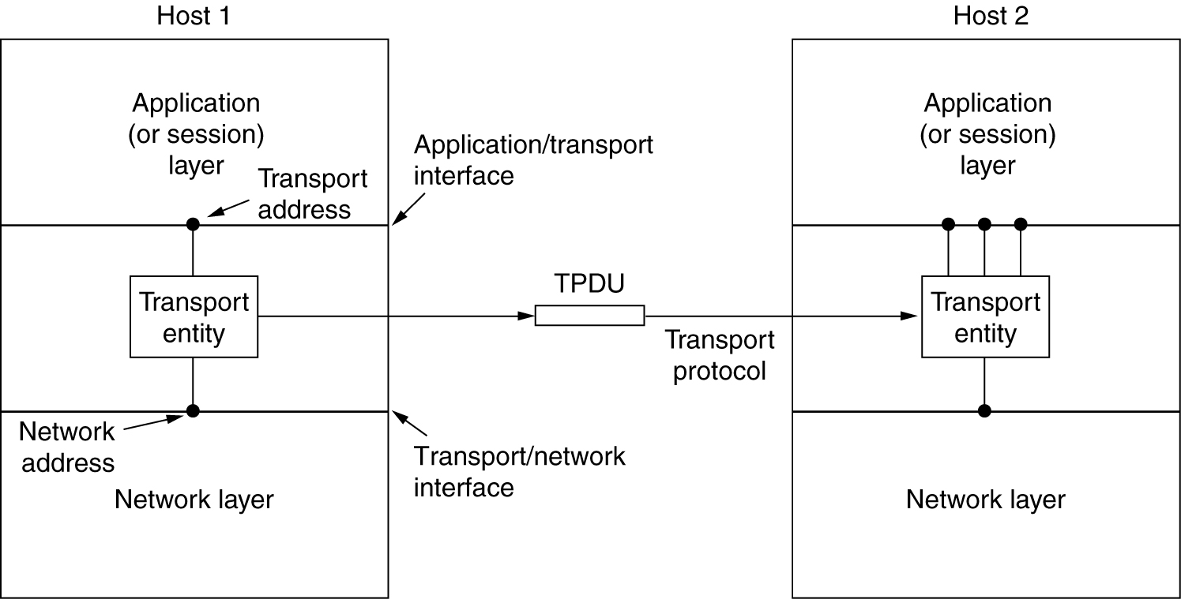
6.1 Service provided to upper layer
The network, transport, and application layers.

Slide 4
Service provide to upper layer
The goal of transport layer is to provide efficient, reliable and cost effective service to its users normally in application layer.
To do this it will use service of network layer like hardware/software.
Transport code runs on user machine while network on routers.
User cannot have control on network service while user have control on transport layer service. Lost packet can be detected using transport layer. So we can have reliable communication.
Bottom layer are known as transport service provider and upper layer are known as transport service user.

Slide 5
6.2 Transport service primitives
To provide access top transport service, transport layer must provide some operations to application programs.
Each transport service has its own interface
It is used to provide reliable service compared to network service because network service is on live networks.
Connection oriented service is used to hide network imperfection that shows an error free bit stream.
Client server computing and multimedia are connectionless services.
Transport services are convenient and easy to use.

Slide 6
6.2 Transport service primitives
When client want to communicate with server , server start first and add listen primitive and client send connect primitives in order to make connection.
Client then send message to another client or server with send and receive primitive.
Then it will send disconnect primitive to server or client.

Slide 7
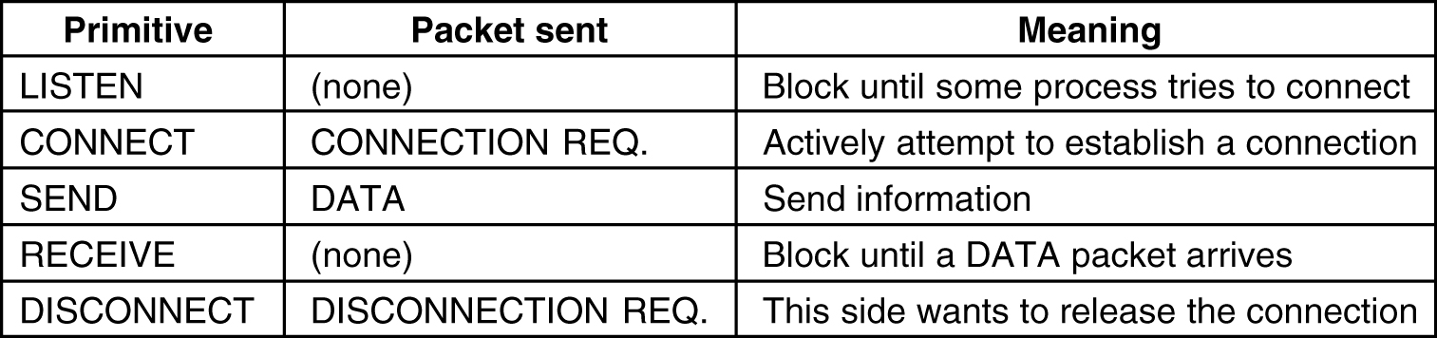
6.2 Transport Service Primitives
The primitives for a simple transport service.

Slide 8
6.2 Transport service primitives
Transport entity to transport entity message follows TDPU(transport protocol data unit) format.
When frame arrive it follows frame header with packet payload of network entity.
The network entity processes the packet header and passes the contents of the packet payload up to the transport entity.
Client send connect TPDU to server then transport entity check server is blocked on a listen mode. It then unblock the server and sends a connection accepted TPDU to client and then client unblocked and connection is established.

Slide 9
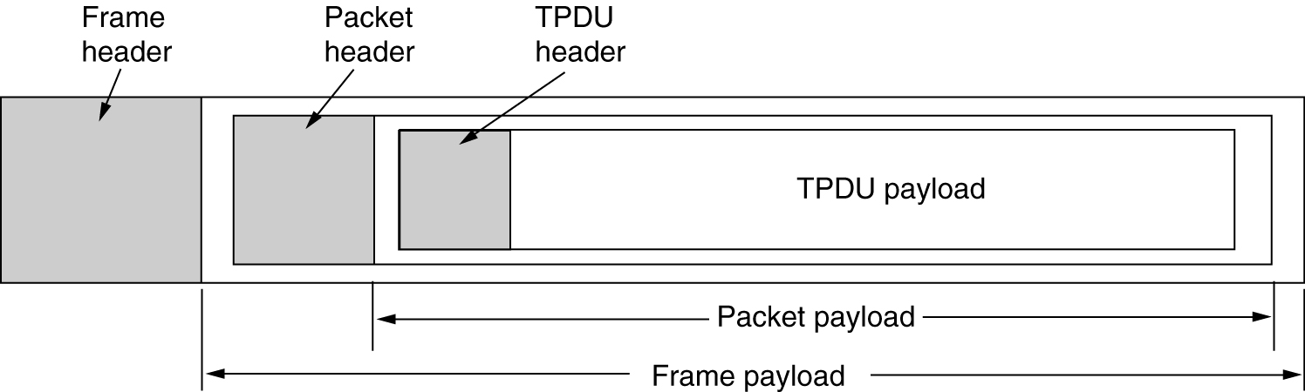
Transport Service Primitives (2)
The nesting of TPDUs, packets, and frames.

Slide 10
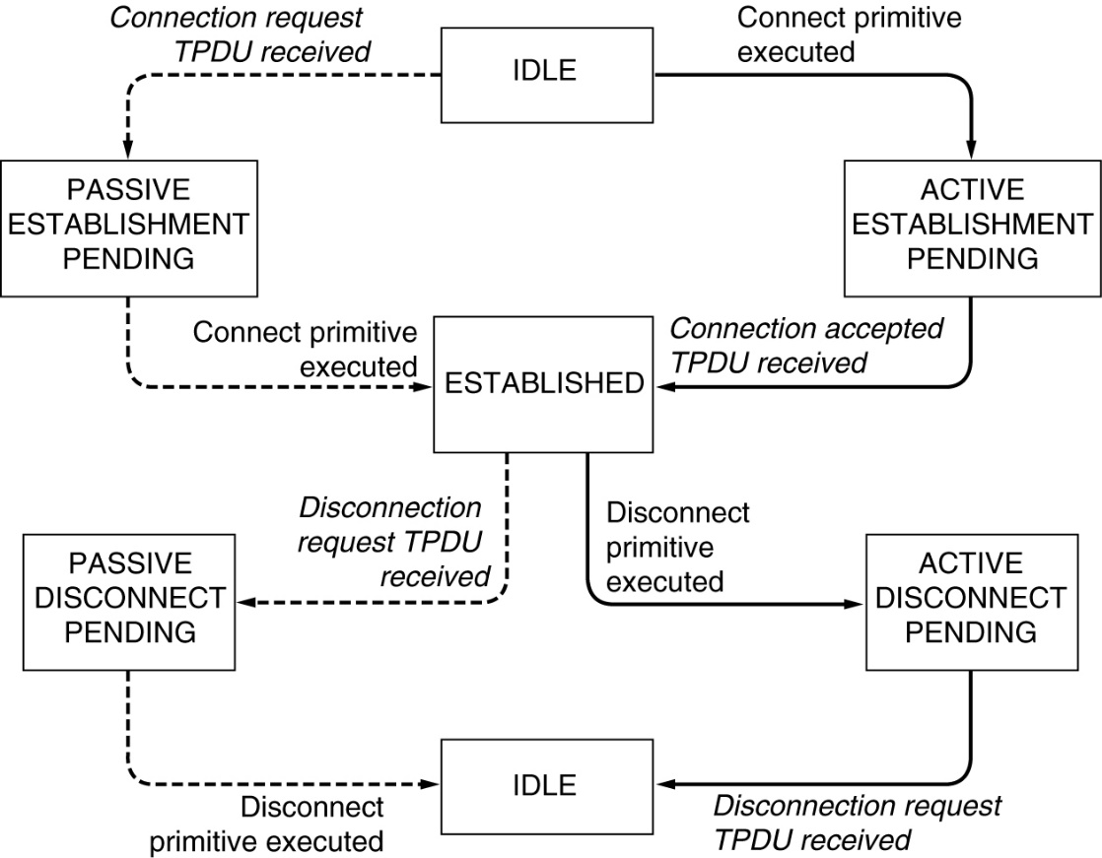
Transport Service Primitives (3)
A state diagram for a simple connection management scheme. Transitions labeled in italics are caused by packet arrivals. The solid lines show the client's state sequence. The dashed lines show the server's state sequence.

Slide 11
6.3 Network Socket
A network socket is an endpoint of an inter-process communication flow across a computer network. Today, most communication between computers is based on the Internet Protocol; therefore most network sockets are Internet sockets.
A socket API is an application programming interface(API), usually provided by the operating system, that allows application programs to control and use network sockets. Internet socket APIs are usually based on the Berkeley sockets standard.
A socket address is the combination of an IP address and a port number, much like one end of a telephone connection is the combination of a phone number and a particular extension. Based on this address, internet sockets deliver incoming data packets to the appropriate application process or thread.

Slide 12
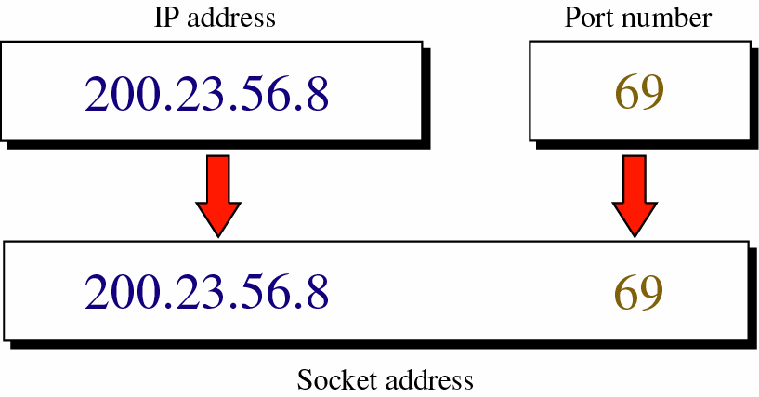
How to create socket address…

Slide 13
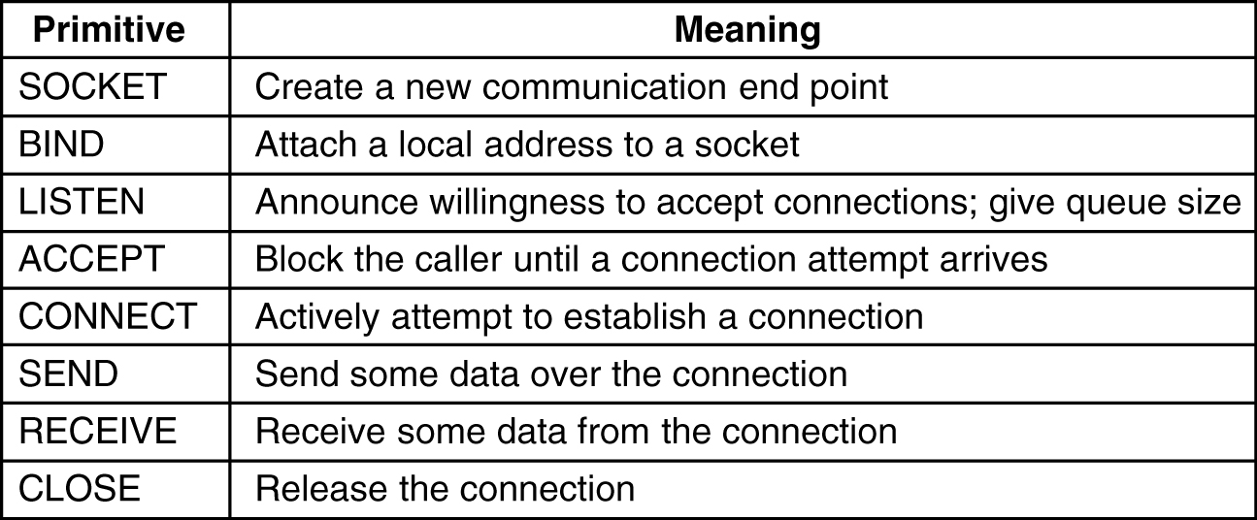
Berkeley Sockets
The socket primitives for TCP.

Slide 14
Berkeley socket
The upper four primitive are server and below four are client primitive.
When socket is created it does not have network address it will get when it using BIND primitive. Now remote client can connect it.
Next is LISTEN call which allocated space to queue incoming calls that several client try to connect at same time.
Now server executes and ACCEPT primitive.
At client side CONNECT primitive will use to make connection here no bind is require. And send and receive is used to send and receive message.

Slide 15
6.4 Elements of Transport Protocols
Addressing
Connection Establishment
Connection Release
Flow Control and Buffering
Multiplexing
Crash Recovery

Slide 16
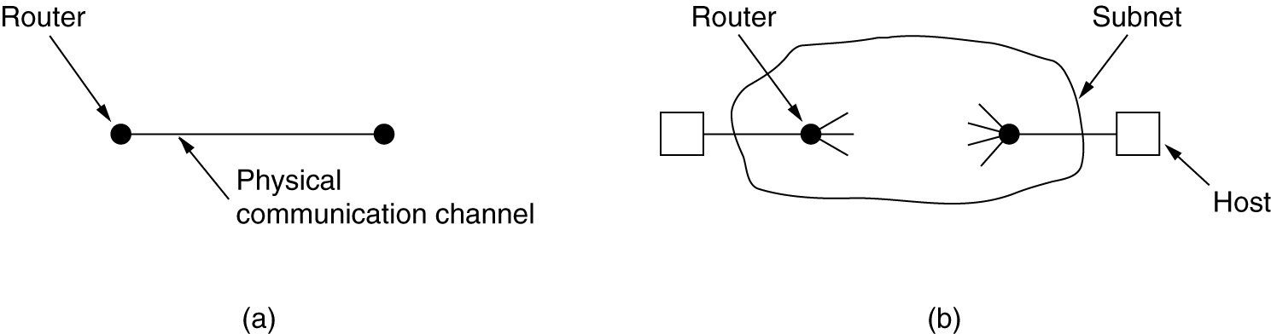
Transport Protocol
In data link layer routers are communicated directly via physical link.
While in transport layer physical link is replaced by subnet.
(a) Environment of the data link layer.
(b) Environment of the transport layer.

Slide 17
Transport protocol similar to data link protocols.
Both do error control and flow control
 | Data link layer | Transport layer
Communication | directly via physical channel | over the entire network
Addressing | no need to specify address. Just select outgoing line | explicit addressing of destination is required
Connection establishment | over a wire is simple | more complicated
Delay | frame either arrives or lost, not stored and delayed | packets might be stored for seconds and delivered later
Buffering and flow control | simpler | more complicated; large and dynamic number of simultaneous connections

Slide 18
6.4.1 Addressing
In transport layer TSAP(transport layer access point ) and NSAP ( network layer access point) is used for addressing.
Application layer connect client and server through TSAP it then run through NSAP on each host.
For example host 2 it self to TSAP 1522 to wait for an incoming call now call such as listen might be used to make request for outside the host.
At host 1 it will send connect request with TSAP 1208 as the source and 1522 as destination. This will make connection.
The application process then sends over a request for the same.
The time server process responds with the current time.
The transport connection is then released.

Slide 19
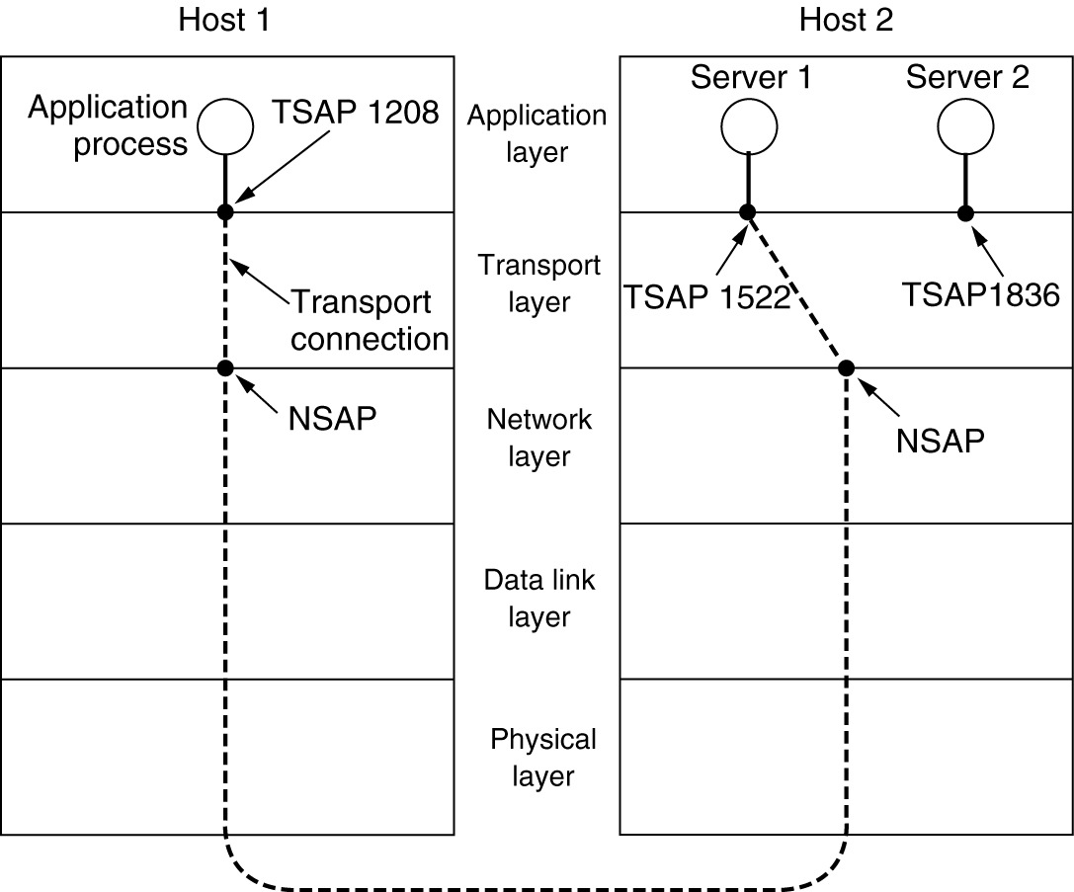
Addressing
TSAPs, NSAPs and transport connections.

Slide 20
Addressing
It is known as the initial connection protocol.
Instead of every conceivable server listening at a well-known TSAP, each machine that wishes to offer services to remote users has a special process server that acts as a proxy for less heavily used servers.
It listens to a set of ports at the same time, waiting for a connection request.
Potential users of a service begin by doing a CONNECT request, specifying the TSAP address of the service they want. If no server is waiting for them, they get a connection to the process server.
Problem here server has to ready on fly basis solution is directory server or name server. Client will register with particular service only like mail or file.

Slide 21
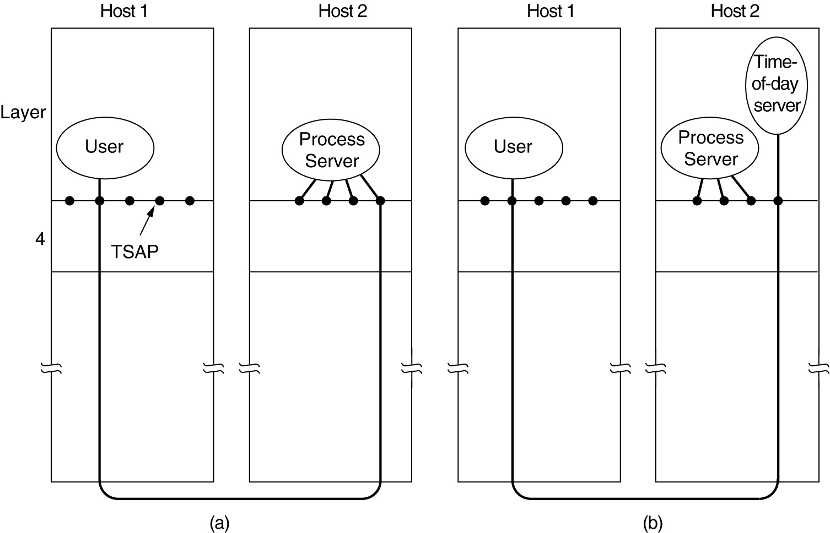
Addressing
How a user process in host 1 establishes a connection with a time-of-day server in host 2.

Slide 22
6.4.2 Connection Establishment
Sounds easy; surprisingly tricky!
Just send REQUEST, wait for ACCEPTED?
Can lose, delay, corrupt, duplicate packets when acknowledgment arrives late or lost
Duplicate may transfer bank money again!
Protocols must work correct all cases
Implemented efficiently in common cases
Main problem is delayed duplicates
Cannot prevent; must deal with (reject)

Slide 23
Connection Establishment
A user establishes a connection with a bank, sends messages telling the bank to transfer a large amount of money to the account of a not-entirely-trustworthy person, and then releases the connection.
Unfortunately, each packet in the scenario is duplicated and stored in the subnet. After the connection has been released, all the packets pop out of the subnet and arrive at the destination in order, asking the bank to establish a new connection, transfer money (again), and release the connection.
The bank has no way of telling that these are duplicates. It must assume that this is a second, independent transaction, and transfers the money again.

Slide 24
Connection Establishment
Solutions for delayed duplicates
Not reuse transport address (TSAP) create new all time.
difficult to connect to process //problem
Give each connection unique ID
seq # chosen by initiating party
update table listing obsolete connections
check new connections against table
requires maintain certain amount of history //problem
if machine crashes, no longer identify old con

Slide 25
Connection Establishment
To simplify problem, restrict packet lifetime
restricted network design: prevent looping
hop counter in each packet: ‐1 at each hop
timestamp in each packet: clock must be synced
Must also guarantee ACKs are dead
Assume a value T of max packet lifetime
T sec after packet sent, sure traces are gone
In the Internet, T is usually 120 seconds

Slide 26
Connection Establishment
New method with packet lifetime bounded
Label segments with seq # not reused in T
T and packet rate determine size of seq #s
1 packet w given seq # may be outstanding
Duplicates may still occur, but discarded dst
Not possible to have delayed duplicate old
packet with same seq # accepted at dest
How to deal with losing memory after crash?
Each host has time‐of‐day clock
clocks at different host need not be synced
binary counter increments uniform intervals
no. of bits must be ≥ of seq #
clock must be running even if host goes down

Slide 27
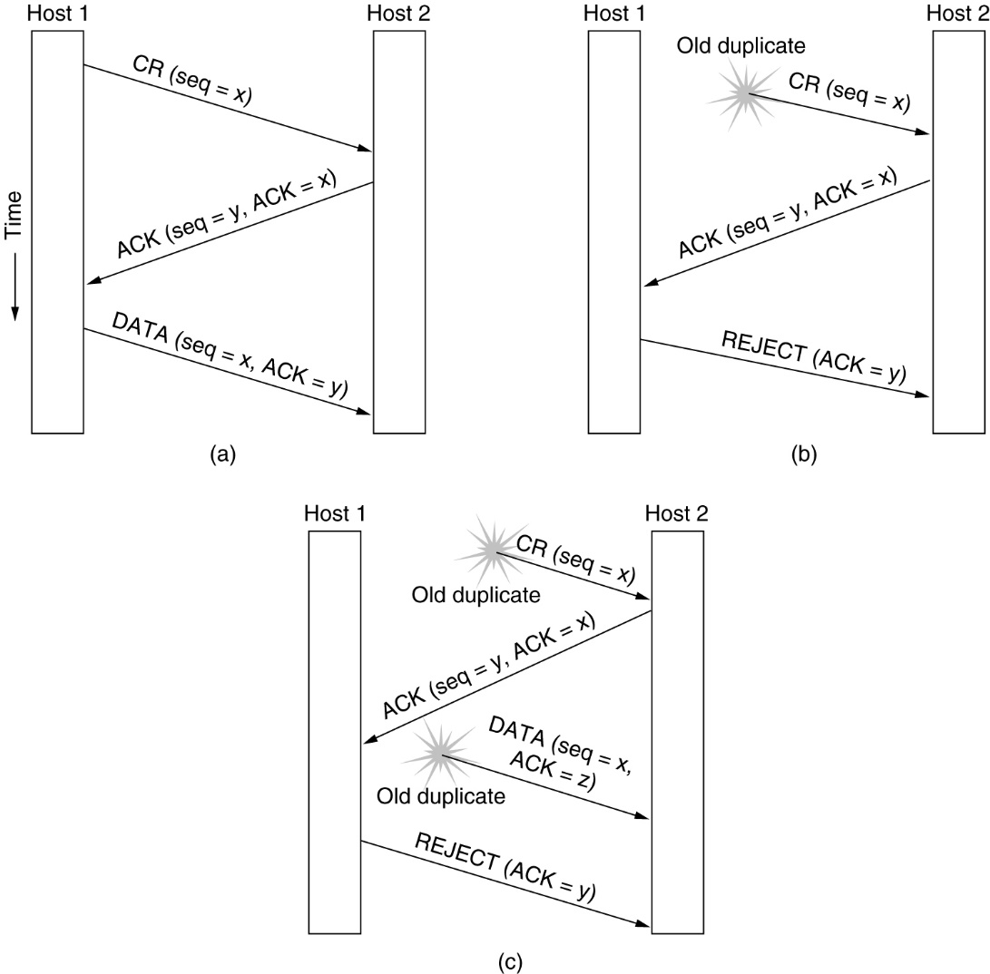
Connection Establishment
Three protocol scenarios for establishing a connection using a three-way handshake. CR denotes CONNECTION REQUEST. (a) Normal operation, (b) Old CONNECTION REQUEST appearing out of nowhere. (c) Duplicate CONNECTION REQUEST and duplicate ACK.

Slide 28
Normal Procedure
H1 choses initial s# x
H2 replies
ACKs x
announce own s# y
H1replies
ACKs y
with 1st data segment

Slide 29
Delayed duplicate CR
H2 sends ACK to H1
H1 rejects
H2 knows it was tricked
Worst case
DD CR, old ACK floating
H2 gets delayed CR, replies
H1 rejects
H2 gets old DATA, discards
(z received instead of y)

Slide 30
Connection Establishment
Three way Handshake:
Check with other peer that con req is current
Used in TCP, with 32‐bit seq #
Clock not used in TCP; attacker can predict
(a) Host 1 chooses a sequence number, x, and sends a CONNECTION REQUEST TPDU containing it to host 2.
Host 2 replies with an ACK TPDU acknowledging x and announcing its own initial sequence number, y.
Finally, host 1 acknowledges host 2's choice of an initial sequence number in the first data TPDU that it sends.
(b) the first TPDU is a delayed duplicate CONNECTION REQUEST from an old connection. This TPDU arrives at host 2 without host 1's knowledge. Host 2 reacts to this TPDU by sending host 1 an

Slide 31
Connection Establishment
ACK TPDU, in effect asking for verification that host 1 was indeed trying to set up a new connection. When host 1 rejects host 2's attempt to establish a connection, host 2 realizes that it was tricked by a delayed duplicate and abandons the connection. In this way, a delayed duplicate does no damage.
(c ) host 2 gets a delayed CONNECTION REQUEST and replies to it. At this point it is crucial to realize that host 2 has proposed using y as the initial sequence number for host 2 to host 1 traffic, knowing full well that no TPDUs containing sequence number y or acknowledgements to y are still in existence.
When the second delayed TPDU arrives at host 2, the fact that z has been acknowledged rather than y tells host 2 that this, too, is an old duplicate.
The important thing to realize here is that there is no combination of old TPDUs that can cause the protocol to fail and have a connection set up by accident when no one wants it.

Slide 32
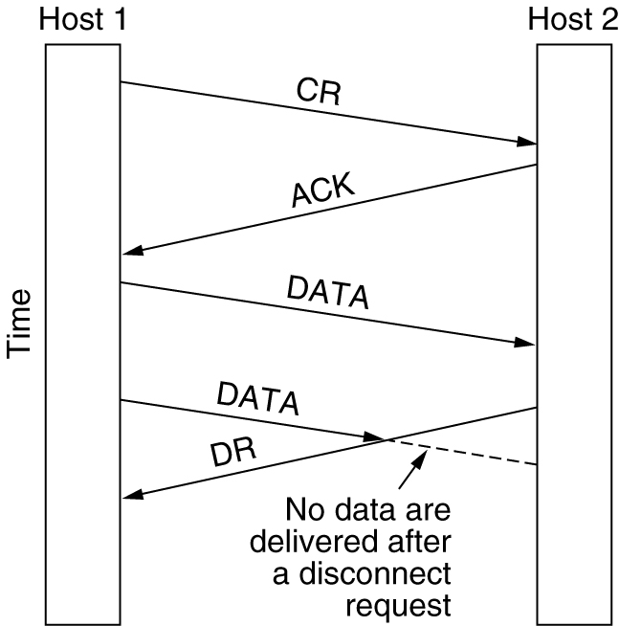
6.4.3 Connection Release
Abrupt disconnection with loss of data.

Slide 33
Connection Establishment
Easier than establish, However, some pitfalls
There are two types of release Asymmetric and symmetric
Asymmetric release
It is like telephone system one party hand up the connection broken
each con term separately
abrupt; may cause data loss
better protocol needed
Symmetric release
Each direction is released independently (two unidirectional line), used only a fixed amount of data with each process
Can receive data after sending DISCONNECT
H1: I am done, are you done too?
H2: I am done too, goodbye
Two‐army problem: unreliable channel

Slide 34
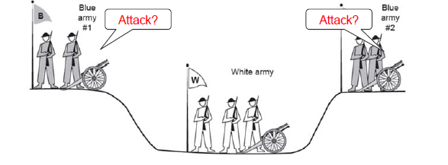
Two‐army problem
each blue army < white army, but together are larger
need to sync attack
however, only com channel is the valley (unreliable)
3‐way handshake? B1 can’t know ACK arrived
making 4‐way handshake doesn’t help either

Slide 35
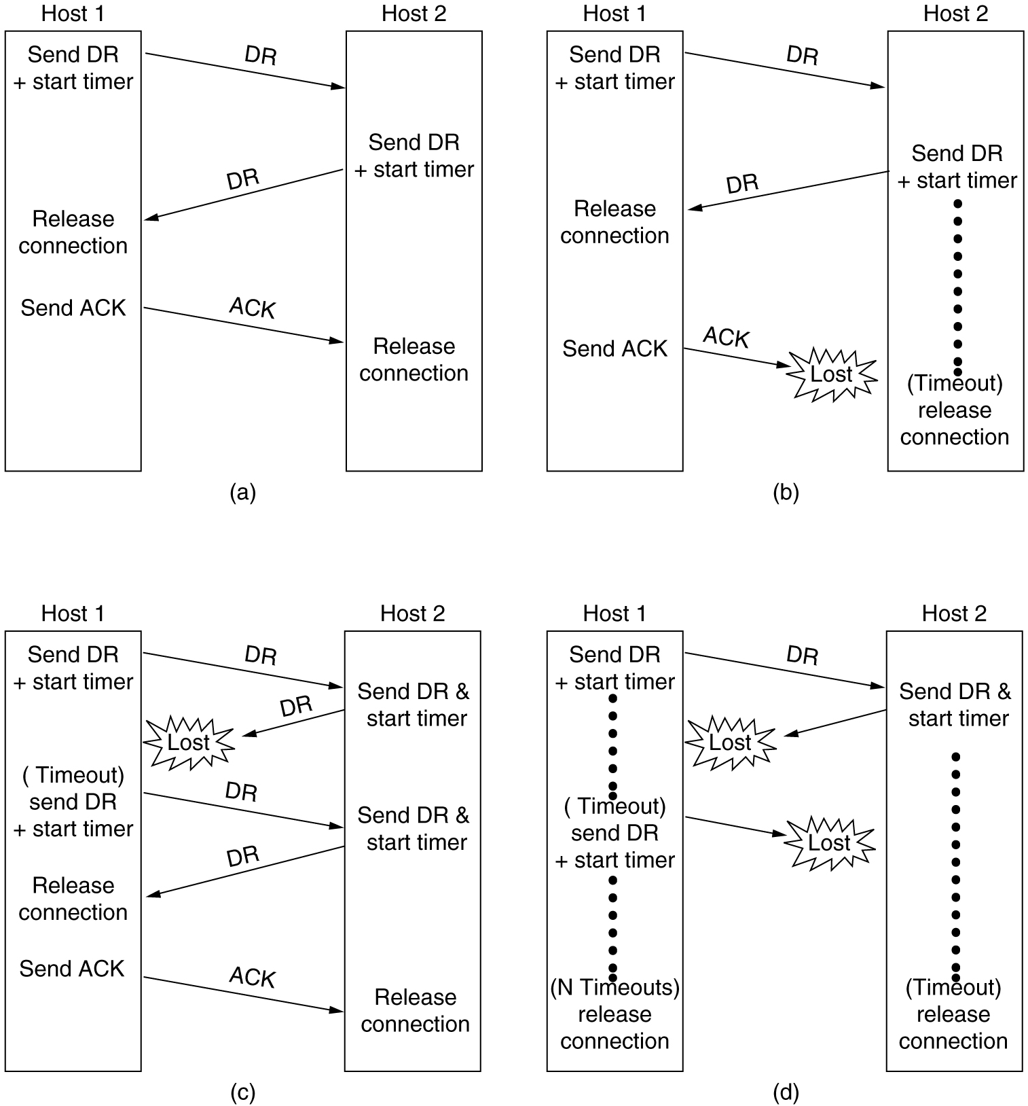
Connection Release
Four protocol scenarios for releasing a connection.
(a) Normal case of a three-way handshake.
(b) final ACK lost.

Slide 36
Connection Release
(c) Response lost.
(d) Response lost and subsequent DRs lost.
6-14, c,d

Slide 37
Connection Release
Protocol usually suffices; can fail in theory
after N lost attempts; half open connection
Not allowing give up, can go on forever
To kill half open connections, automatically
disconnect if no received segments in X sec
Must have timer reset after each segment
Send dummy segments to keep con alive
TCP normally does symmetric close, with
each side independently close ½ con w FIN

Slide 38
6.4.4 Flow Control and Buffering
Flow control is require at data link layer and transport layer.
both layers a sliding window or other scheme is needed on each connection to keep a fast transmitter from overrunning a slow receiver.
The main difference is that a router usually has relatively few lines, whereas a host may have numerous connections. So it is not possible to implement at transport layer.
In data link layer both sender and receiver are required to dedicate MAX_SEQ + 1 buffers to each line, half for input and half for output.
For a host with a maximum of, say, 64 connections, and a 4-bit sequence number, this protocol would require 1024 buffers.

Slide 39
Flow Control and Buffering
(a) If the buffer size is chosen equal to the largest possible TPDU, space will be wasted whenever a short TPDU arrives.
If the buffer size is chosen less than the maximum TPDU size, multiple buffers will be needed for long TPDUs, with the attendant complexity.
(b) user variable size buffer, The advantage here is better memory utilization, at the price of more complicated buffer management.
(c ) A third possibility is to dedicate a single large circular buffer per connection.
This system also makes good use of memory, provided that all connections are heavily loaded, but is poor if some connections are lightly loaded.
For low-bandwidth busty traffic, it is better to buffer at the sender, and for high bandwidth smooth traffic, it is better to buffer at the receiver.

Slide 40
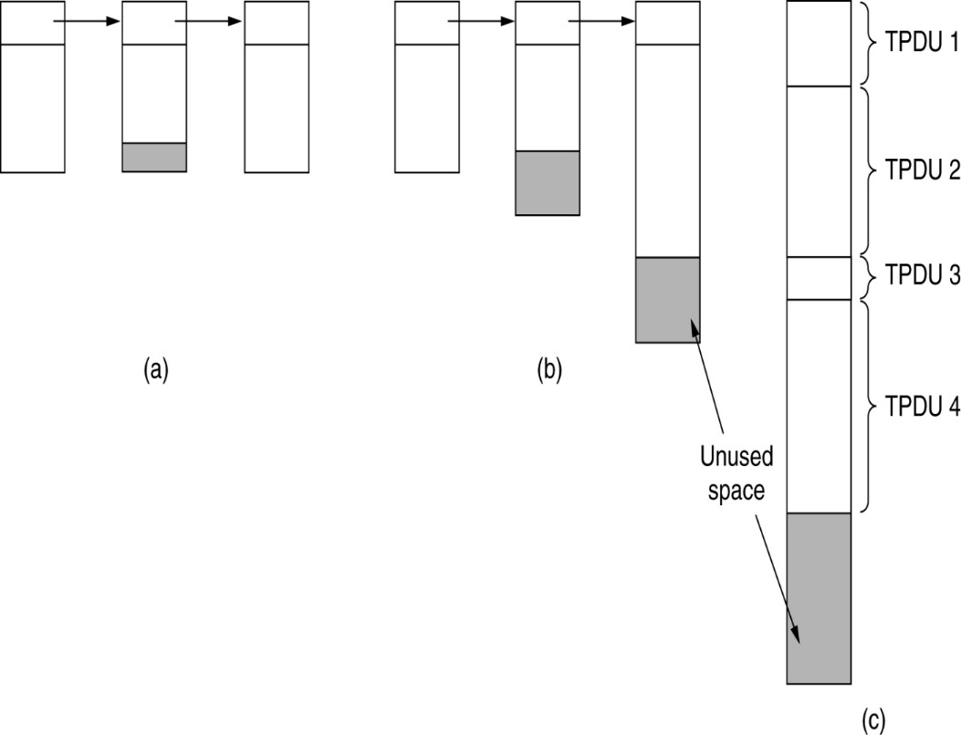
Flow Control and Buffering
(a) Chained fixed-size buffers. (b) Chained variable-sized buffers. (c) One large circular buffer per connection.

Slide 41
6.4.5 Multiplexing
Multiplexing several conversations onto connections, virtual circuits.
In the transport layer the need for multiplexing can arise in a number of ways. For example, if only one network address is available on a host, all transport connections on that machine have to use it.
When a TPDU comes in, some way is needed to tell which process to give it to. This situation, called upward multiplexing.
Downward multiplexing is used to share available bandwidth. When user need more bandwidth it will take bandwidth of unutilized stations.

Slide 42
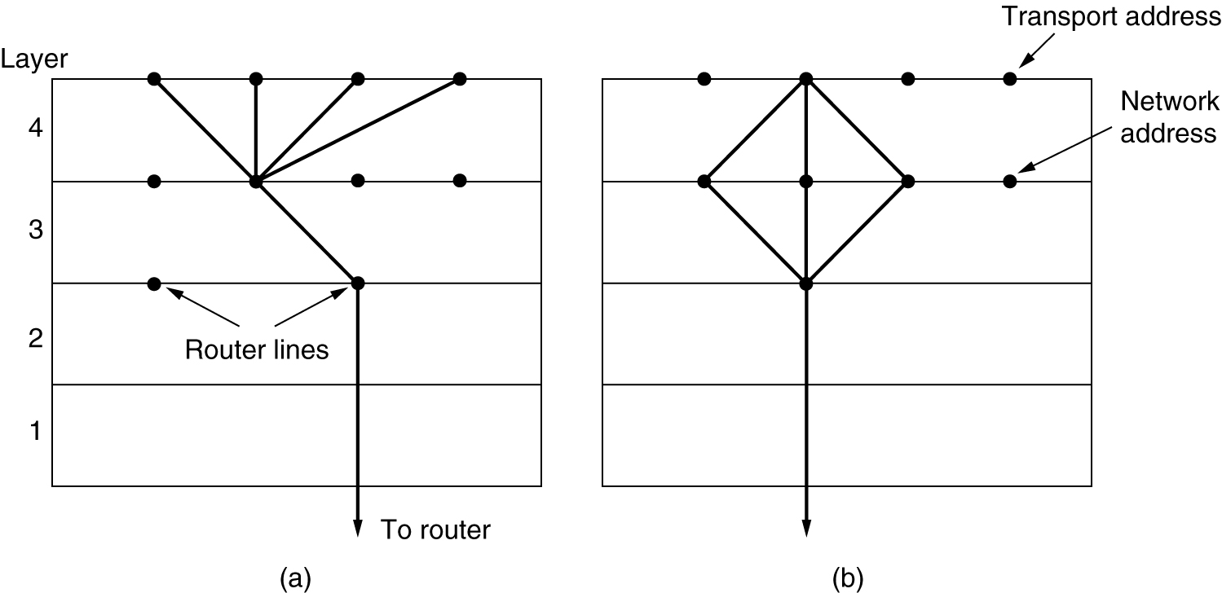
Multiplexing
(a) Upward multiplexing. (b) Downward multiplexing.

Slide 43
6.4.6 Crash Recovery
If hosts and routers are subject to crashes, recovery from these crashes becomes an issue.
If the transport entity is entirely within the hosts, recovery from network and router crashes is straightforward.
If the network layer provides datagram service, the transport entities expect lost TPDUs all the time and know how to cope with them.
If the network layer provides connection-oriented service, then loss of a virtual circuit is handled by establishing a new one and then probing the remote transport entity to ask it which TPDUs it has received and which ones it has not received. The latter ones can be retransmitted.

Slide 44
If server crash what happen?
In an attempt to recover its previous status, the server might send a broadcast TPDU to all other hosts, announcing that it had just crashed and requesting that its clients inform it of the status of all open connections.
Each client can be in one of two states: one TPDU outstanding, S1, or no TPDUs outstanding, S0. Based on only this state information, the client must decide whether to retransmit the most recent TPDU.

Slide 45
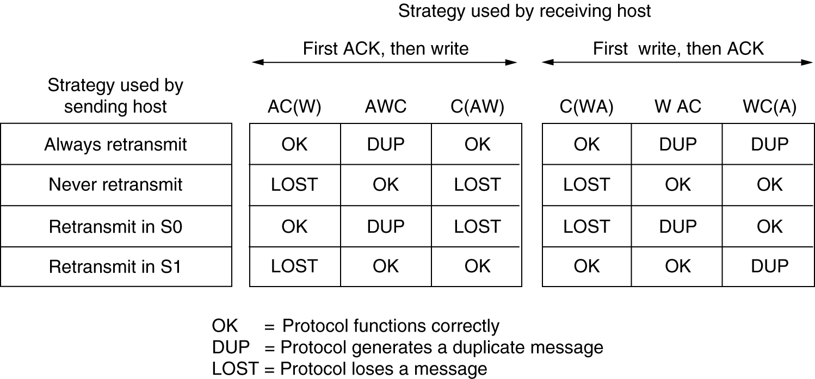
Crash Recovery
Different combinations of client and server strategy.

Slide 46
6.5 USER DATAGRAM PROTOCOL (UDP)
The User Datagram Protocol (UDP) is called a connectionless, unreliable transport protocol. It does not add anything to the services of IP except to provide process-to-process communication instead of host-to-host communication.

Slide 47
Table Well-known ports used with UDP

Slide 48
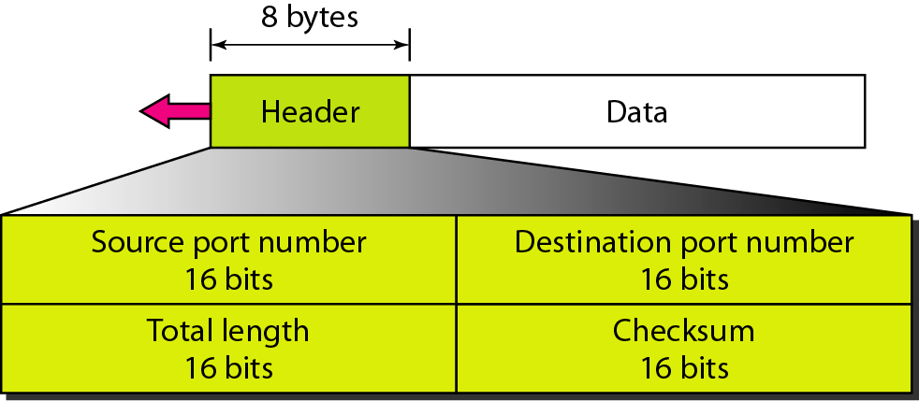
Figure User datagram format
Note: UDP length = IP length – IP header’s length

Slide 49
UDP packets, called user datagram's have a fixed size header of 8 bytes.
Source Port Number: it is a 16 bit long which is assign to process running on source host.
Destination Port Number: it is a 16 bit long which is assign to process running on destination host.
Length: it is a 16 bit that defines the total length of the user datagram, header plus data.
A user datagram is encapsulated in IP datagram. There is a field in the IP datagram that defines the total length.
Checksum: this field is used to detect errors over the entire user datagram.

Slide 50
The checksum includes three sections: a pseudoheader, the UDP header and the data coming from the application layer.
the pseudoheader is the part of the header of the IP packet in which the user datagram is to be encapsulated with some fields with 0s.
If the checksum does not include the pseudoheader a user datagram may arrive safe.
The protocol filed is added to ensure that the packet belongs to UDP and not to other transport layer protocols. The value of protocol field is 17. if this value is changed checksum will changed.

Slide 51
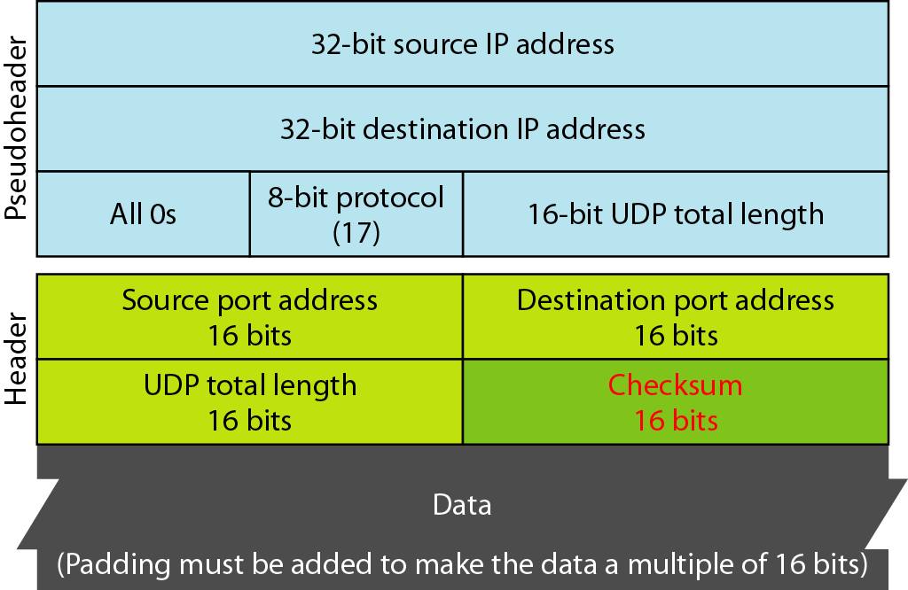
Figure Pseudoheader for checksum calculation

Slide 52
Example
Figure shows the checksum calculation for a very small user datagram with only 7 bytes of data. Because the number of bytes of data is odd, padding is added for checksum calculation. The pseudoheader as well as the padding will be dropped when the user datagram is delivered to IP.

Slide 53
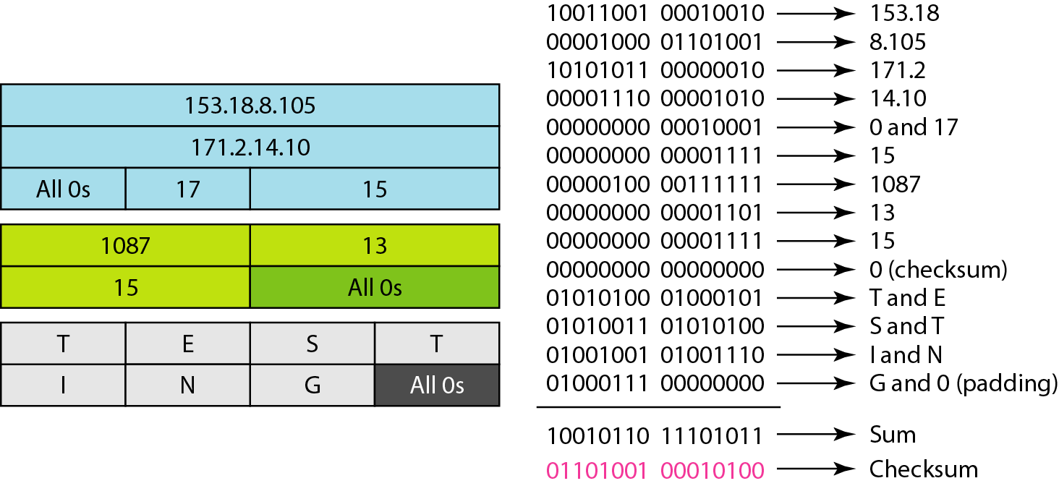
Figure Checksum calculation of a simple UDP user datagram

Slide 54
UDP Operations & Uses
Operations:
Connectionless Services – can send only short messages
No Flow and Error Control so no window mechanism
Encapsulation and Decapsulation
Queuing
Uses:
For a process that requires simple request-response communication
For a process with internal flow and error control mechanisms
For multicasting
For management processes such as SNMP
For some route updating protocols such as routing information protocol

Slide 55
6.6 TCP (Transmission Control Protocol
TCP is a connection-oriented protocol; it creates a virtual connection between two TCPs to send data. In addition, TCP uses flow and error control mechanisms at the transport level.

Slide 56
Table Well-known ports used by TCP

Slide 57
Services Offered by TCP:
1. Process to Process Communication: It provide process to process communication using port.
2. Stream Delivery Service: It is stream oriented protocol. In UDP a process sends messages with predefined boundaries, to UDP for delivery. UDP adds its own header to each of these messages and delivers them to IP for transmission.
In TCP , it allows sending process to deliver data as a stream of bytes and allows the receiving process to obtain data as a stream of bytes. It creates and imaginary tubes that carries their data across the internet.
3. Sending and receiving buffers: TCP needs buffer as sending and reading is not done at same speed. There are two buffers. It is implemented using circular array of 1 byte locations.
Sender side buffer has three types of chambers. White section contains empty chambers, the gray area holds bytes that require ack. Colored area contains bytes need to send.

Slide 58
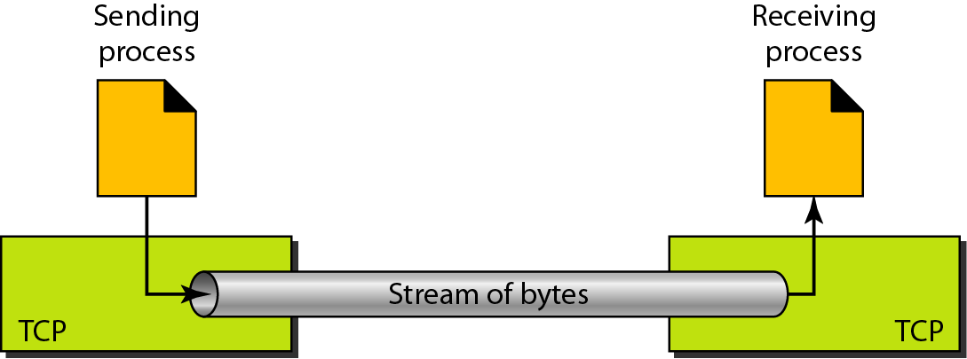
Figure Stream delivery

Slide 59
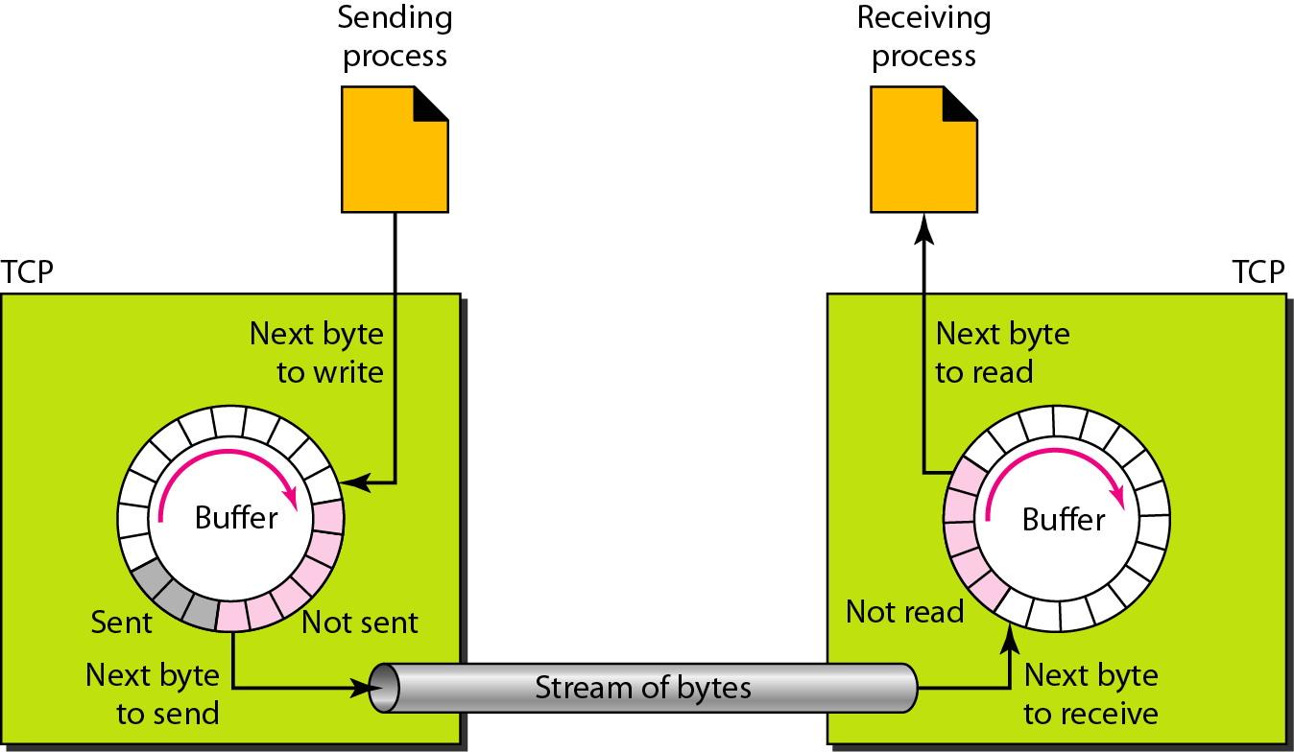
Figure Sending and receiving buffers

Slide 60
After byte in the grey chambers are acknowledged the chambers are recycled and available for use by the sending process.
The operation of the buffer at the receiver site is simpler. The circular buffer is divided into two areas.
The white area contains empty chambers to be filled by bytes received from the network.
The colored sections contain received bytes that can be read by the receiving process. When a byte is read by the receiving process, the chamber is recycled and added to the pool of empty chambers.
4. Segments: TCP groups a number of bytes together into a packet called a segment. TCP adds a header to each segment and delivers the segment to the IP layer for transmission. It is not necessary to have segment of same size.

Slide 61
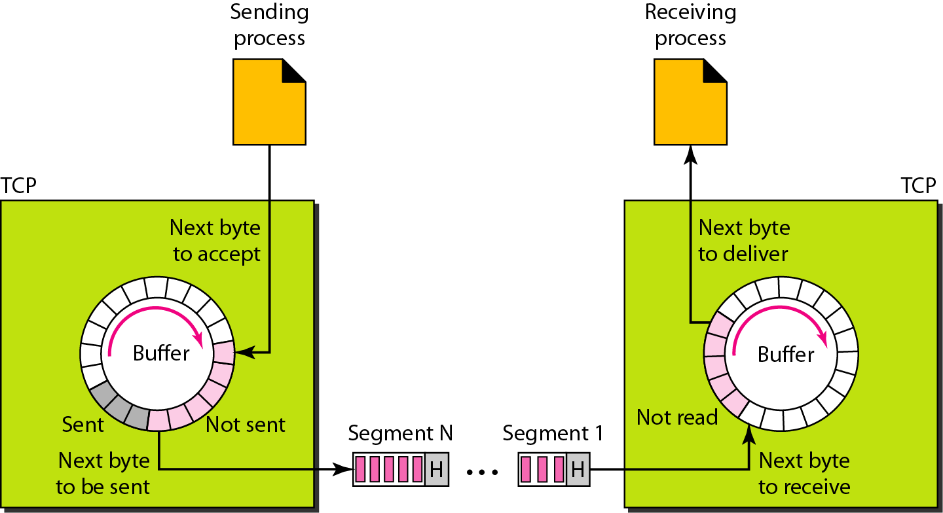
Figure TCP segments

Slide 62
5. Full Duplex communication: TCP offers full duplex service in which data can flow in both directions at the same time.
6. Connection oriented service: TCP establish virtual connection between two host not physical. Host would like to transmit data will do following.
The two TCPs establish a connection between them
data are exchanged in both directions
The connection is terminated.
7. Reliable Service: TCP is a reliable transport protocol. It uses an acknowledgment mechanism to check the safe and sound arrival of data.

Slide 63
TCP Features – Numbering System
The bytes of data being transferred in each connection are numbered by TCP.
It has sequence number and the acknowledgment number.
The numbering starts with a randomly generated number.
The value in the sequence number field of a segment defines the number of the first data byte contained in that segment.
The value of the acknowledgment field in a segment defines the number of the next byte a party expects to receive. The acknowledgment number is cumulative.

Slide 64
TCP Features
Flow control
Error control
Congestion Control

Slide 65
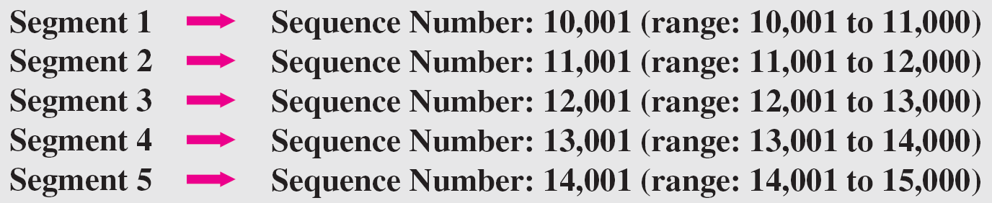
Example
The following shows the sequence number for each segment:

Slide 66
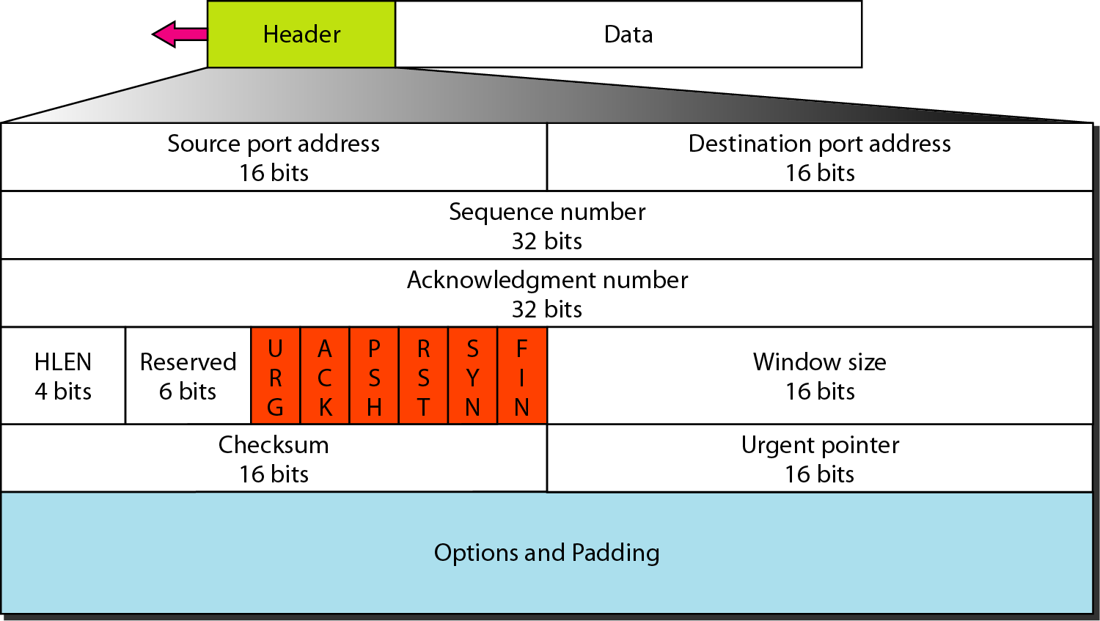
Figure TCP segment format

Slide 67
Source Port Address: It is a 16 bit field defines the port number of the source program.
Destination port address: it is a 16 bit field defines the port number of destination program.
Sequence number: this 32 bit field defines the number assigned to the first byte of data contained in this segment.
Acknowledgment numbers: this 32 bit field defines the byte number that the receiver of the segment is expecting to receive from the other party.
Header Length: This 4 bit field indicates the number of 4 byte words in the TCP header. It is from 20 to 60 bytes. If 5(5*4=20).
Reserved: this is a 6 bit field reserved for future used.
Control: This filed defines 6 different control bits or flags.

Slide 68
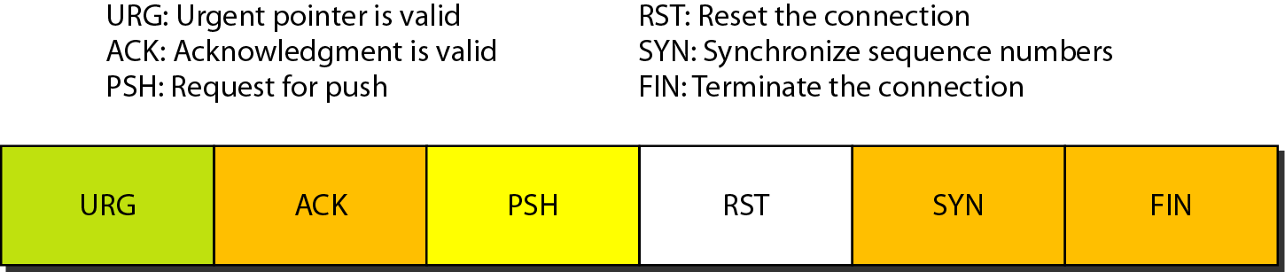
Figure Control field
Table Description of flags in the control field

Slide 69
This control bits enable flow control, connection establishment and termination, connection abortion and the mode of data transfer in TCP.
Window Size: This field defines the size of the window in bytes that the other party must maintain. It is 16 bits field.
Checksum: this 16 bit field contain checksum.
Urgent Pointer: It is 16 bit field which is valid only if the urgent flag is set is used when the segment contains urgent data.
Options: there can be up to 40 bytes of optional information in the TCP header.

Slide 70
Connection Establishment
TCP transmit data in full duplex mode.
It use Three way handshaking.
In this process server start first and tell its TCP that it is ready. This is called passive open.
The client program issues a request for an Active open.
Client sends the first segment, a SYN segment in which only the SYN flag is set. When data transfer start this number will increment.
The server sends the second segment a SYN+ACK segment, with 2 flag bit set. It does not carry data but consume one sequence number.
The client send third segment this is just an Ack segment. The ACK segment does not consume any sequence numbers.

Slide 71
Connection Establishment
SYN flooding attack: It has a problem of SYN flooding attack.
When malicious attacker sends a large number of SYN segments to a server, pretending that each of them is coming form a different client by faking the source IP address in the datagram.
The TCP server then sends the SYN+ACK segments to the fake clients, which are lost.
If during this short time the number of SYN segments is large, the server eventually runs out of resources and may crash. It is also known as a denial of service attack.

Slide 72
A SYN segment cannot carry data, but it consumes one sequence number.
A SYN + ACK segment cannot carry data, but does consume one sequence number.
An ACK segment, if carrying no data, consumes no sequence number.

Slide 73
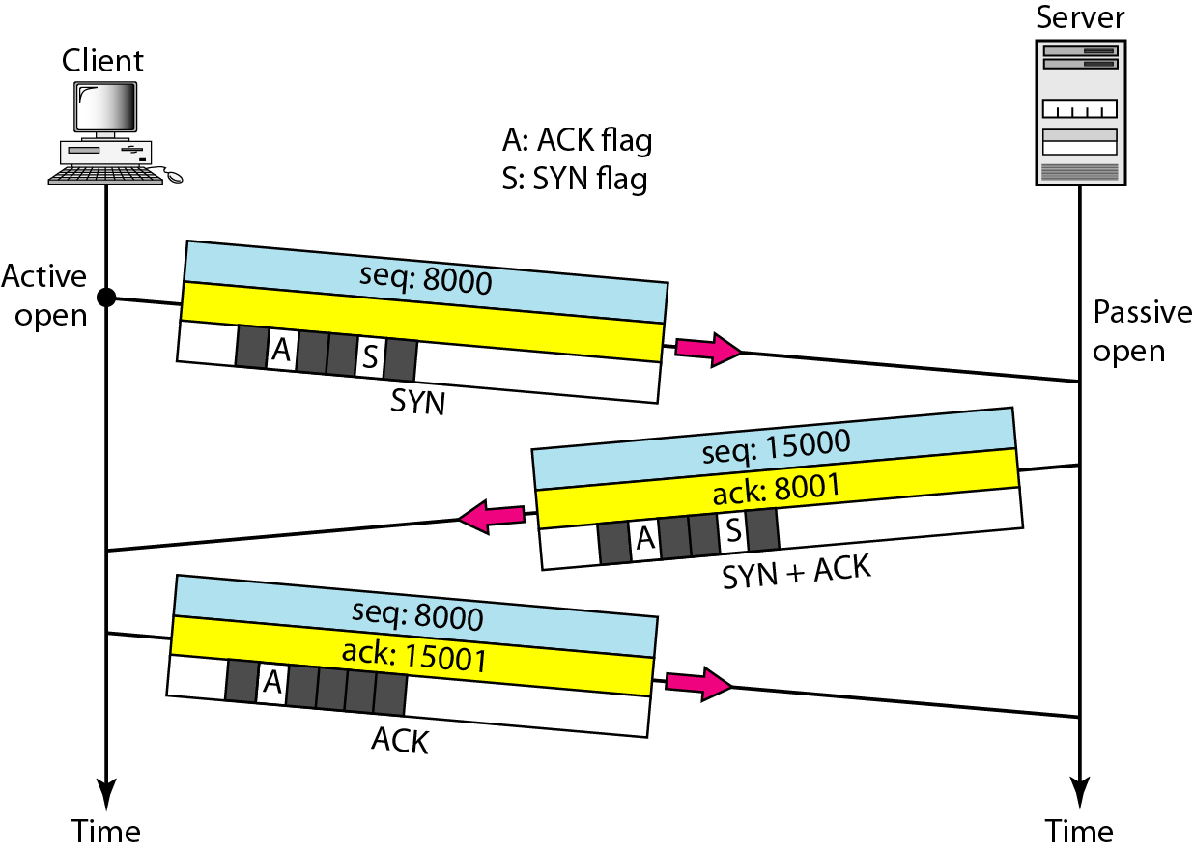
Figure Connection establishment using three-way handshaking

Slide 74
Data transfer
After data connection bidirectional data transfer take place.
The client and server can both send data and acknowledgments.
The acknowledgment is piggy backed with the data.
The client sends 2000 bytes of data in two segments. The server then sends 2000 bytes in one segment. The client sends one more segment. The first three segments carry both data and acknowledgment, but the last segment carries only an acknowledgment because there are no more data to be sent.
When delay is not allowed in data it can be handled by push data operation. Sending application program send a push request operation that data must reach immediately.
Urgent data is used by receiver when it would like to receive data urgent. Urgent field will set.

Slide 75
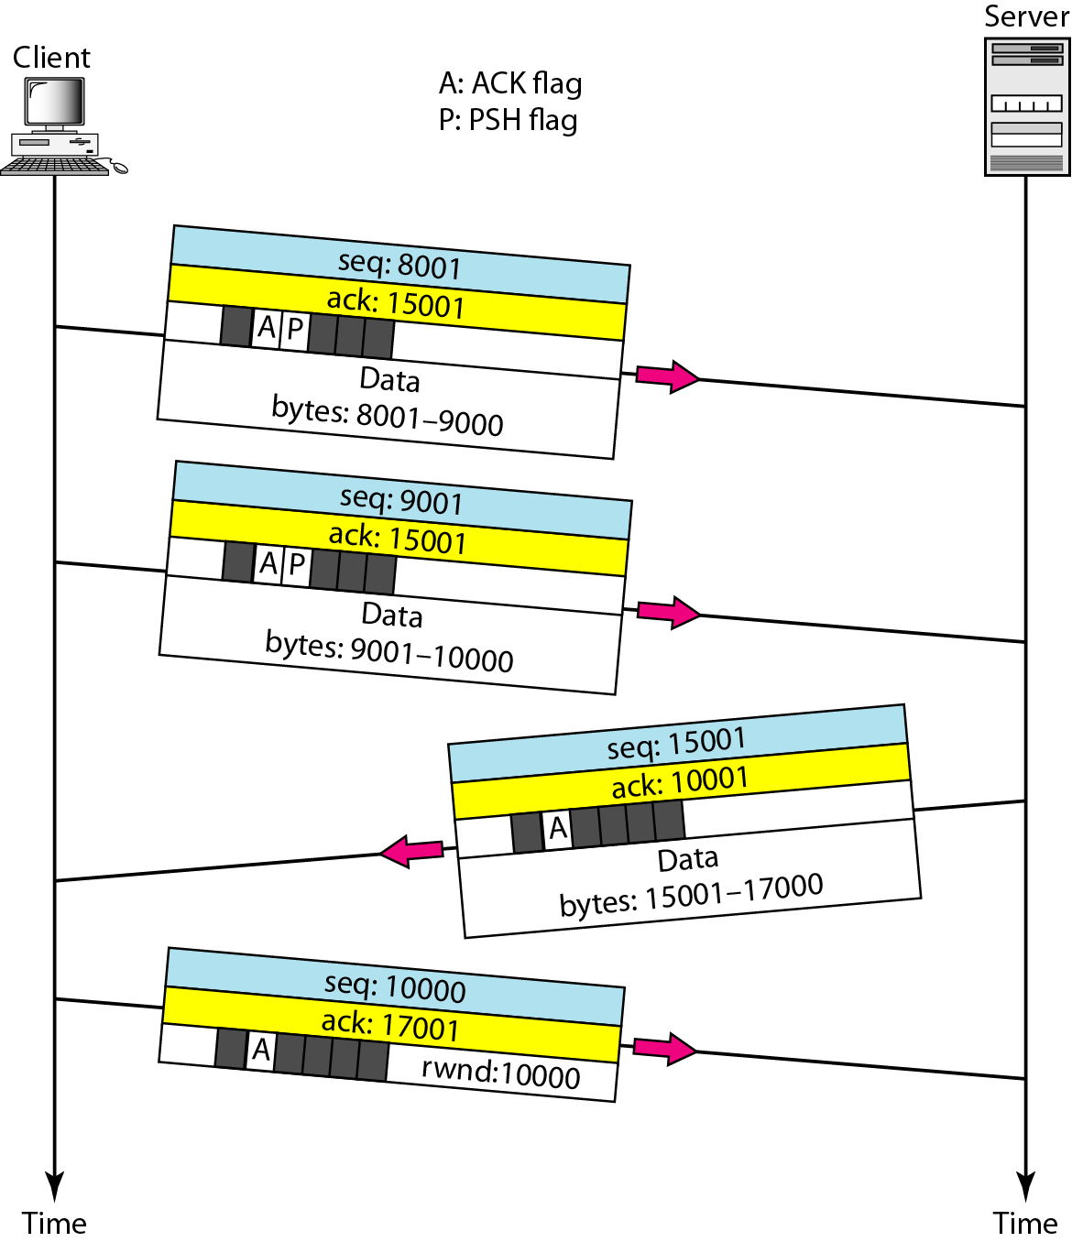
Figure Data transfer

Slide 76
Connection Termination
Any of two parties can close the connection.
Client TCP after receiving a close command from the client process sends the first segment , a FIN segment in which the FIN flag is set. It include last chunk of data sent by the client or a control segment. It consume one sequence number if not data.
The server TCP then send FIN + ACK segment to confirm the receipt of FIN.
It consume one sequence number if no data.
The client TCP sends the last segment an ACK segment , to confirm the receipt of the FIN segement.
It is also possible to half close the connection. One end stop sending data while other is still receive.
Sorting is an example of half close where client send data to sort and then close sending connection but still receive data.

Slide 77
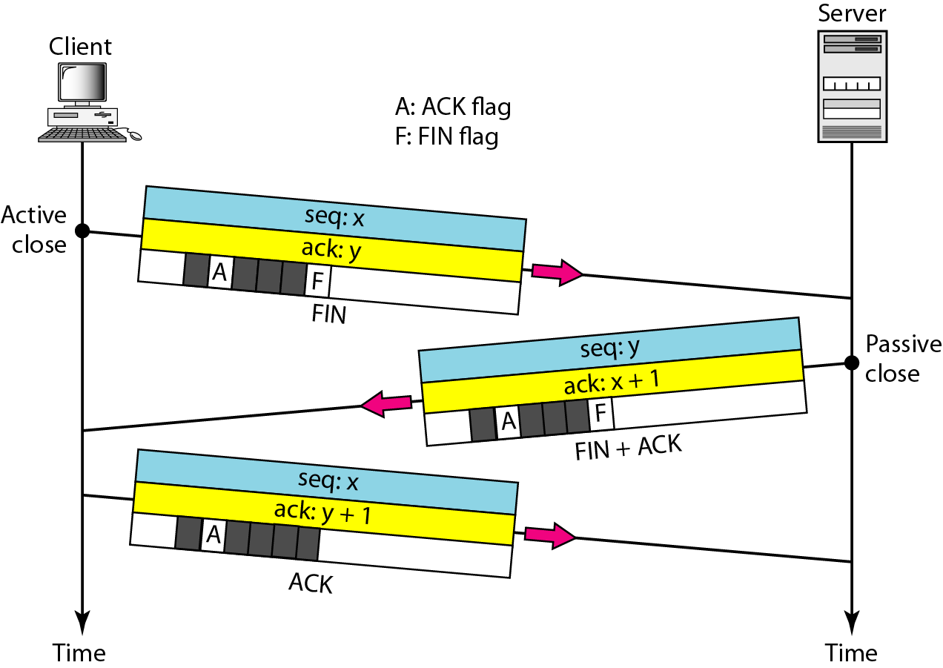
Figure Connection termination using three-way handshaking

Slide 78
Thank You

